Slide 1
RISK STRATIFICATION & MANAGEMENT OF STEMI

Slide 2
INTRODUCTION
All patients with ST-elevation myocardial infarction (STEMI) should undergo risk stratification soon after presentation.
Early risk stratification provides the patient and family with some sense of what the future holds.
Late risk stratification attempts to identify patients who are at increased risk for late arrhythmic or non arrhythmic death.

Slide 3
Acute Phase
Early phase
Late phase

Slide 4
Acute Phase Risk Stratification:
Electrocardiographic features
Anterior MI/ Persisting ST elevation
Q waves in multiple leads
RVMI + IWMI
High sum of ST elevation
Reciprocal ( anterior ) ST depression
Persisting ST depression
Prolonged QT
Conduction defects/ heart block
Sinus tachycardia/arrythmia

Slide 5
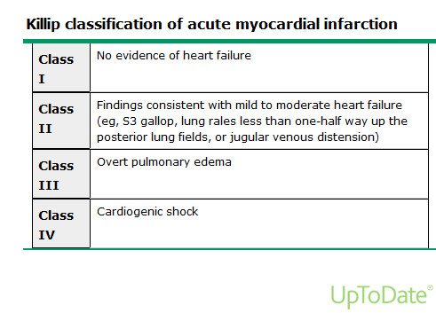
Acute Phase Risk Stratification:
Importance of LV dysfunction
(Killip T, and Kimball JT: Treatment of myocardial infarction in a coronary care unit: a two year experience of 250 patients. American Journal of Cardiology 1967; 20: 457-464 )

Slide 6
EARLY RISK STRATIFICATION
All STEMI patients should undergo risk assessment with one of the tools presented below within the first four to six hours of hospitalization.
Analyses from other large clinical trials and registries, a number of different risk scores have been developed to assess short- and long-term outcomes after STEMI.

Slide 7
TIMI risk score
TIMI risk index
GRACE risk model
CHADS2 score
ACTION registry score
Zwolle primary PCI index
CADILLAC risk score

Slide 8
TIMI risk score
TIMI risk score - is an arithmetic sum of eight independent predictors of mortality :
Age ≥75 years – 3 points
Age 65 to 74 years – 2 points
History of diabetes, hypertension, or angina – 1 point
Systolic blood pressure <100 mmHg – 3 points
Heart rate >100/min – 2 points
Killip class II to IV and – 2 points
Weight <67 kg – 1 point
Anterior ST elevation or left bundle branch block – 1 point
Time to reperfusion therapy >4 hours – 1 point
Notes:
The TIMI risk score, based upon data from 15,000 patients with an STEMI eligible for fibrinolytic therapy

Slide 9
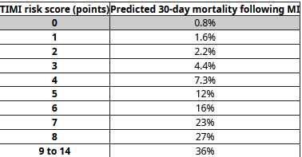
Entry criteria: Chest pain for more than 30 minutes, ST elevation, symptom onset less than 6 hours, fibrinolytic eligible.
Notes:
The usefulness of the TIMI risk score to predict in-hospital mortality was validated in a community-based population of 84,029 patients; the predictive accuracy of the TIMI risk score was the same in those treated with fibrinolysis or percutaneous coronary intervention, but underestimated mortality in those not undergoing reperfusion therapy .

Slide 10
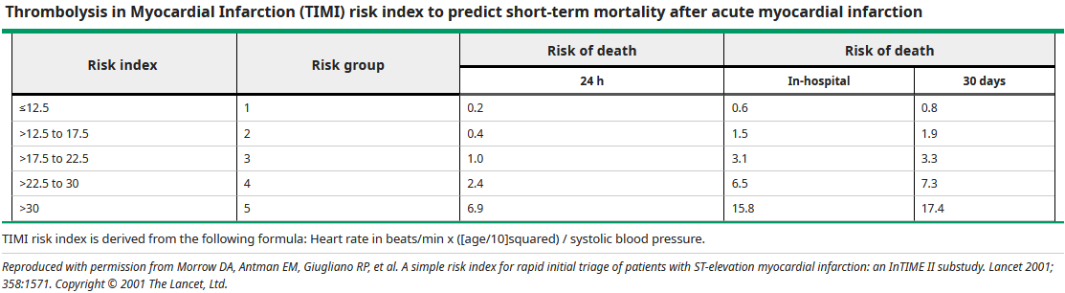
TIMI risk index
Notes:
TRI derived from the InTIME-II trial of fibrinolytic therapy and then validated in other populations to predict in-hospital mortality

Slide 11
GRACE risk model
The GRACE registry, a global registry of acute coronary syndrome (ACS) patients from 94 hospitals in 14 countries, developed two models to estimate the risk of both in-hospital and six-month mortality among all patients with an ACS.

Slide 12
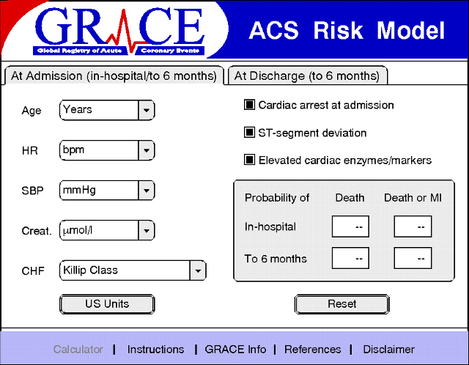

Slide 13
The six-month model was based upon data from 15,007 patients and validated in a cohort of 7638 patients, all in the GRACE registry.
Age,
History of heart failure & myocardial infarction
Resting heart rate & systolic blood pressure
ST-segment depression
Initial serum creatinine
Serum cardiac biomarkers, and performance of in-hospital PCI.

Slide 14
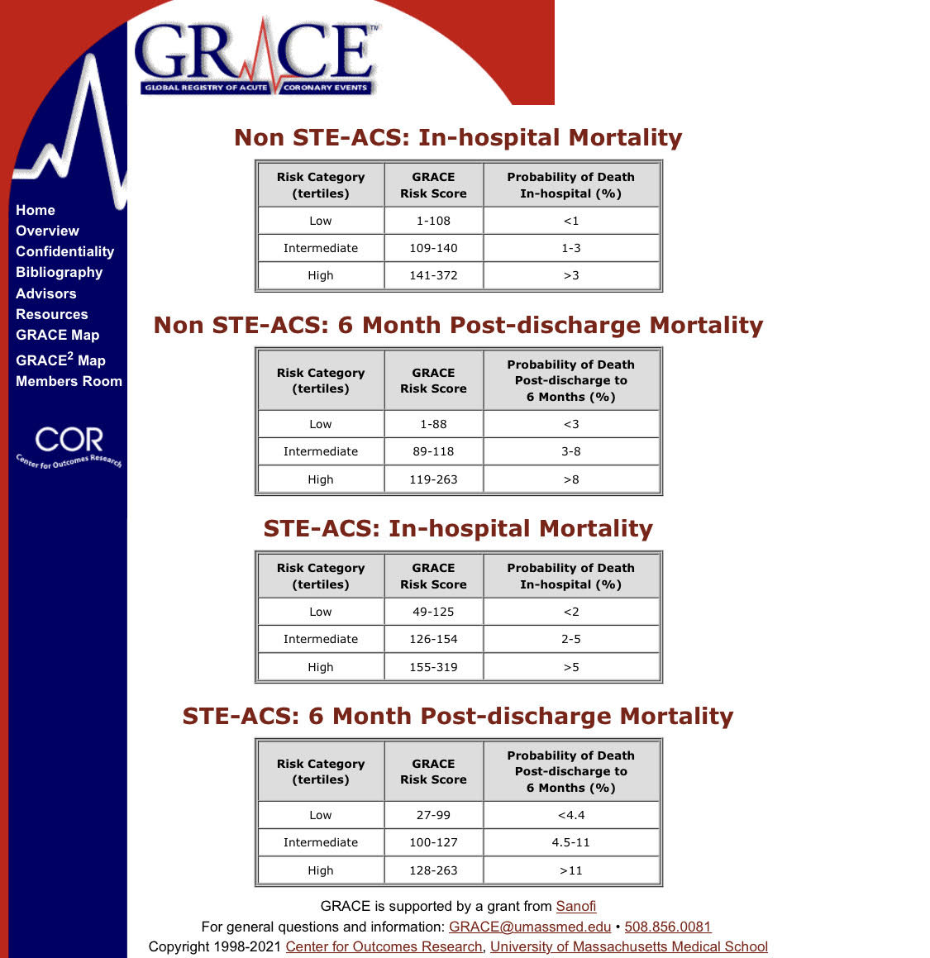

Slide 15
ACTION registry score
The Acute Coronary Treatment and Intervention Outcomes Network (ACTION) - predict in-hospital mortality following STEMI and NSTEMI .
Data from 243,440 patients showed - Greater Heart Rate, Lower Systolic Blood Pressure, Life-threatening Presentations (Cardiac Arrest, Cardiogenic Shock, Or Heart Failure), STEMI At Presentation, Lower Creatinine Clearance, And Higher Troponin Values were associated with death during the hospitalization.
Likely to be most helpful for persons with moderate to severe disease and reflects more contemporary experience than TIMI or GRACE.

Slide 16
Zwolle primary PCI index
A risk index based upon a primary PCI population was developed in Zwolle, the Netherlands from data on 1791 patients between 1994 and 2001.
Significant independent risk factors for 30-day mortality.
The risk index was validated in an additional group of 747 patients with similar characteristics treated with primary PCI between 2001 and 2003.

Slide 17
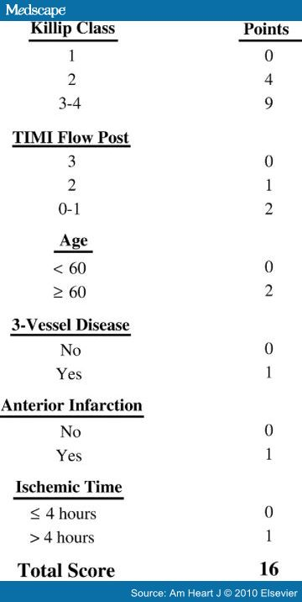
The Zwolle index generates a risk score, on a scale of 0 to 16
Score 0 to 3: Low risk & can be discharged
Score 4 or more: Are considered as high-risk category

Slide 18
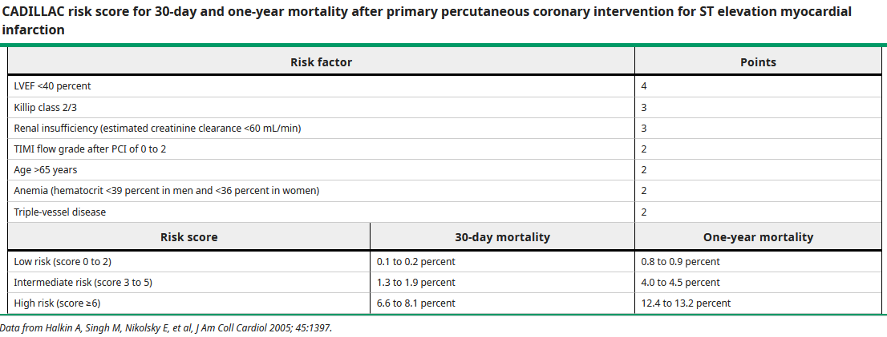
CADILLAC risk score
Notes:
CADILLAC Controlled Abciximab and Device Investigation to Lower Late Angioplasty Complications trial .The CADILLAC^{[45]} score was developed to predict 30-day and 1-year mortality following primary PCI

Slide 19
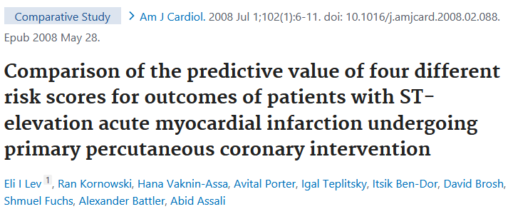

Slide 20
The prognostic value of the TIMI, PAMI, CADILLAC, and GRACE risk scores was directly compared in 855 registry patients with STEMI, but without cardiogenic shock, who underwent primary PCI.
The TIMI, PAMI, and CADILLAC scores had relatively high and similar predictive accuracies for 30-day and one-year mortality; the GRACE model performed less well.
The CADILLAC score was judged to be unhelpful prior to angiography because LVEF is a key component.

Slide 21
LATE RISK STRATIFICATION
Left ventricular ejection fraction
Right ventricular ejection fraction
Stress testing
Other post-myocardial infarction associations

Slide 22
Left ventricular ejection fraction
Patients with left ventricular systolic dysfunction have increased mortality at six months and one year.
Patients with LVEF ≤35 percent are at increased risk for sudden cardiac death after MI and should be considered candidates for an ICD.
Degree of LVEF between two and seven days following an acute MI and second determination 2 to 12 weeks following an MI predicted a high risk of sudden death and mortality.

Slide 23
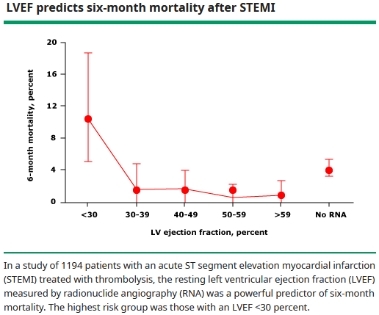

Slide 24
Use of Noninvasive Testing for Ischemia Before Discharge
I
IIa
IIb
III
Noninvasive testing for ischemia should be performed before discharge to assess the presence and extent of inducible ischemia in patients with STEMI who have not had coronary angiography and do not have high-risk clinical features for which coronary angiography would be warranted.
B
I
IIa
IIb
III
Noninvasive testing for ischemia might be considered before discharge to evaluate the functional significance of a noninfarct artery stenosis previously identified at angiography.
I
IIa
IIb
III
Noninvasive testing for ischemia might be considered before discharge to guide the postdischarge exercise prescription.

Slide 25
Post MI Management:
Pre-discharge TMT
Sub maximal protocol
  Target workload =5 METS, 70 % MPHR or symptom limited
Predictors of poor outcome
  Ischemic ST depression > 1 mm is inconsistent predictor of mortality
  Poor exercise tolerance < 3 minutes doubles one year mortality ( 7%to14%)
  Inability to exercise or contra-indication to TMT identifies High Risk patient.

Slide 26
Other post-myocardial infarction associations
The extent of angiographic coronary artery disease
Two biomarkers, NT-proBNP (N-terminal pro-B-type natriuretic peptide) and GDF-15 (growth differentiation factor-15)
Worsening post-discharge renal function
Influenza and other viral respiratory infections concomitant with acute MI

Slide 27
SUMMARY
All patients with ST-elevation myocardial infarction (STEMI) should undergo risk stratification soon after presentation.
Risk stratification in a patient with STEMI occurs in two phases: early in-hospital identification of patients at increased risk for recurrent ischemic events and identification of patients after an MI who are at increased risk for arrhythmic or nonarrhythmic death.
For early risk stratification, prefer the TIMI risk score or the GRACE risk model.

Slide 28
Regional Systems of STEMI Care, Reperfusion Therapy, and Time-to-Treatment Goals
I
IIa
IIb
III
All communities should create and maintain a regional system of STEMI care that includes assessment and continuous quality improvement of EMS and hospital-based activities. Performance can be facilitated by participating in ACS programs.
B
I
IIa
IIb
III
Performance of a 12-lead ECG by EMS personnel at the site of FMC is recommended in patients with symptoms consistent with STEMI.
B

Slide 29
Regional Systems of STEMI Care, Reperfusion Therapy, and Time-to-Treatment Goals
I
IIa
IIb
III
Reperfusion therapy should be administered to all eligible patients with STEMI with symptom onset within the prior 12 hours.
A
I
IIa
IIb
III
Primary PCI is the recommended method of reperfusion when it can be performed in a timely fashion by experienced operators.
A
I
IIa
IIb
III
EMS transport directly to a PCI-capable hospital for primary PCI is the recommended triage strategy for patients with STEMI with an ideal FMC-to-device time system goal of 90 minutes or less.*
B
*The proposed time windows are system goals. For any individual patient, every effort should be made to provide reperfusion therapy as rapidly as possible.

Slide 30
Regional Systems of STEMI Care, Reperfusion Therapy, and Time-to-Treatment Goals
I
IIa
IIb
III
When fibrinolytic therapy is indicated or chosen as the primary reperfusion strategy, it should be administered within 30 minutes of hospital arrival.*
B
I
IIa
IIb
III
Reperfusion therapy is reasonable for patients with STEMI and symptom onset within the prior 12 to 24 hours who have clinical and/or ECG evidence of ongoing ischemia. Primary PCI is the preferred strategy in this population.
B
*The proposed time windows are system goals. For any individual patient, every effort should be made to provide reperfusion therapy as rapidly as possible.

Slide 31
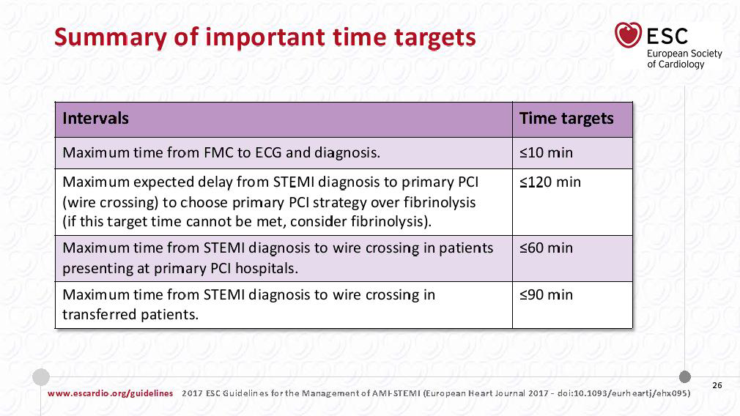

Slide 32
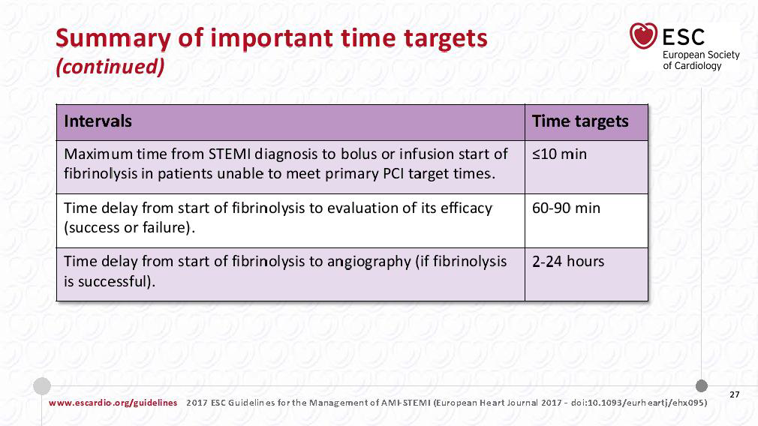

Slide 33
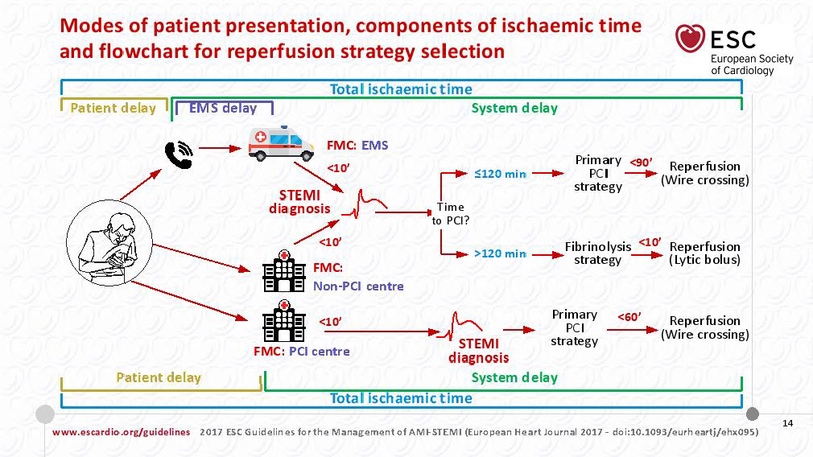

Slide 34
Initial Recognition and Management in the Emergency Department
Airway, Breathing, Circulation (ABC)
Vital signs, general observation
Presence or absence of jugular venous distension
Pulmonary auscultation for rales
Cardiac auscultation for murmurs and gallops
Presence or absence of stroke

Slide 35
Control of cardiac pain
Pain contribute to the heightened sympathetic activity
Typically accomplished with combination of nitrates, analgesics, oxygen and β-blocker
Nitroglycerin Class I (C)
Nitrates should not be administered to patients with:
      systolic pressure < 90 mm Hg or ≥ to 30 mm Hg below baseline
      severe bradycardia (< 50 bpm)
      suspected RV infarction.
      who have received a phosphodiesterase.

Slide 36
Analgesia
    Morphine sulfate (2 to 4 mg intravenously) Class I (C)
    NSAIDS Increase risk of cardiovascular events so should be discontinued
[A sub study analysis from the ETRACT TIMI-25 trial showed increased risk of death, reinfarction, heart failure, or shock among patients on NSAIDs within 7 days of enrollment].
Oxygen
  Arterial oxygen desaturation (SaO₂ < 90%) Class I(B)

Slide 37
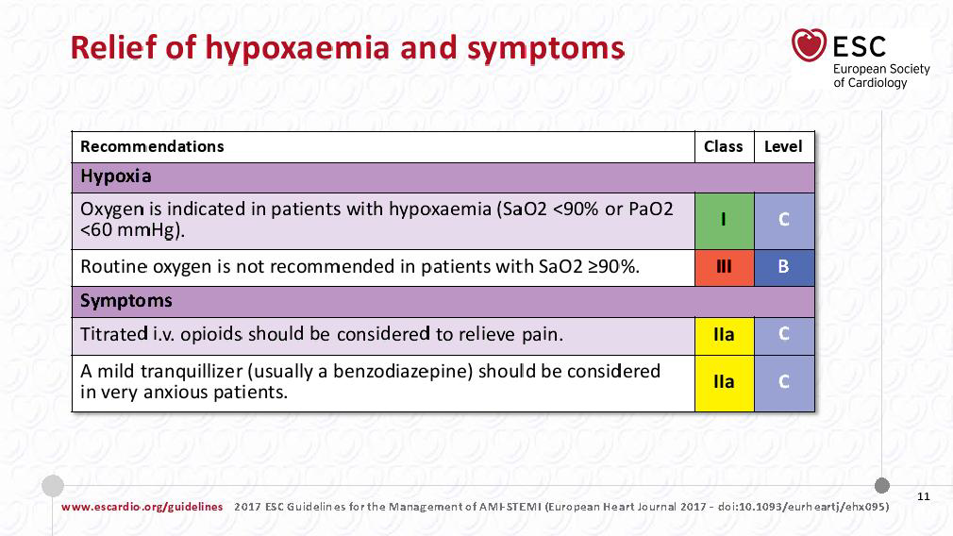

Slide 38
Onset of Myocardial Infarction
The Relationship Between Sudden Cardiac Death and STEMI

Slide 39
Onset of Myocardial Infarction
Evaluation and Management of Patients With STEMI and Out-of-Hospital Cardiac Arrest

Slide 40
Evaluation and Management of Patients With STEMI and Out-of-Hospital Cardiac Arrest
I
IIa
IIb
III
Therapeutic hypothermia should be started as soon as possible in comatose patients with STEMI and out-of-hospital cardiac arrest caused by VF or pulseless VT, including patients who undergo primary PCI.
B
I
IIa
IIb
III
Immediate angiography and PCI when indicated should be performed in resuscitated out-of-hospital cardiac arrest patients whose initial ECG shows STEMI.
B

Slide 41
Guideline for STEMI
Reperfusion at a
PCI-Capable Hospital

Slide 42
Primary PCI in STEMI
I
IIa
IIb
III
Primary PCI should be performed in patients with STEMI and ischemic symptoms of less than 12 hours’ duration.
A
I
IIa
IIb
III
Primary PCI should be performed in patients with STEMI and ischemic symptoms of less than 12 hours’ duration who have contraindications to fibrinolytic therapy, irrespective of the time delay from FMC.
B
I
IIa
IIb
III
Primary PCI should be performed in patients with STEMI and cardiogenic shock or acute severe HF, irrespective of time delay from MI onset.
B

Slide 43
Primary PCI in STEMI
I
IIa
IIb
III
Primary PCI is reasonable in patients with STEMI if there is clinical and/or ECG evidence of ongoing ischemia between 12 and 24 hours after symptom onset.
B
I
IIa
IIb
III
PCI should not be performed in a noninfarct artery at the time of primary PCI in patients with STEMI who are hemodynamically stable
B
Harm

Slide 44
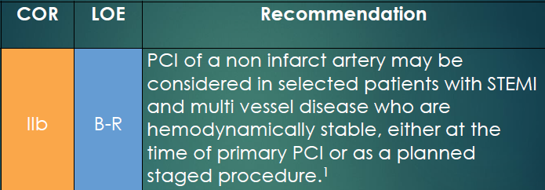
1. Modified recommendation from 2013 Guideline (changed class from III: Harm to IIb and expanded time frame in which multivessel PCI could be performed).
Notes:
Four RCTs (PRAMI, CULPRIT, DANAMI 3 PRIMULTI, PRAGUE-13) have since suggested that a strategy of multivessel PCI, either at the time of primary PCI or as a planned, staged procedure, may be safe and beneficial in selected patients with STEMI.
On the basis of these findings, the prior Class III-harm recommendation with regard to multivessel primary PCI in hemodynamically stable patients with STEMI has been upgraded and modified to a Class IIb recommendation to include consideration of multivessel PCI, either at the time of primary PCI or as a planned, staged procedure.
The writing committee emphasizes that this change should not be interpreted as endorsing the routine performance of multivessel PCI in all patients with STEMI and multivessel disease. Rather, when considering the indications for and timing of multivessel PCI, physicians should integrate clinical data, lesion severity/complexity, and risk of contrast nephropathy to determine the optimal strategy.

Slide 45
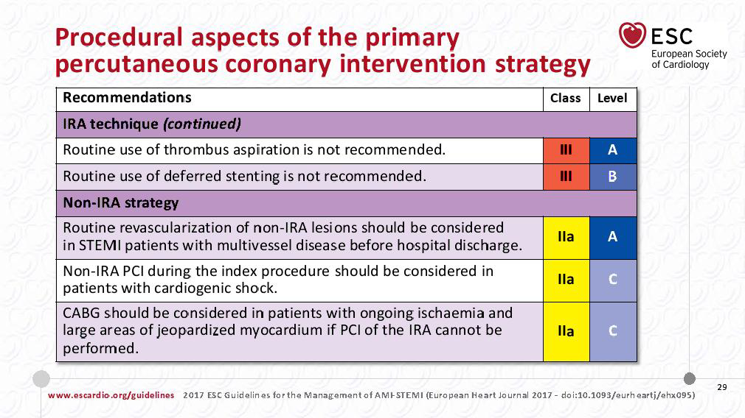

Slide 46
Aspiration Thrombectomy
I
IIa
IIb
III
Manual aspiration thrombectomy is reasonable for patients undergoing primary PCI.
B

Slide 47
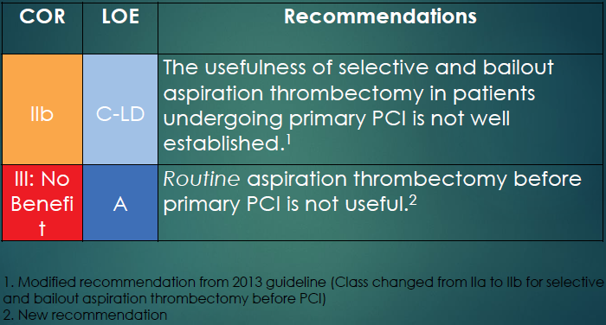
INFUSE-AMI, TASTE, TOTAL trials
Notes:
The 2011 PCI and 2013 STEMI guidelines’ Class IIa recommendation for aspiration thrombectomy before primary PCI was based on the results of 2 RCTs and 1 meta-analysis and was driven in large measure by the results of TAPAS, a single-center study.
Since formulation of that recommendation, 3 multicenter trials (INFUSE-AMI, TASTE, TOTAL), 2 of which enrolled significantly more patients than prior aspiration thrombectomy trials, have prompted re-evaluation of this recommendation.
These 3 more recent trials, as well as an updated meta-analysis, found no significant reduction in adverse events with routine aspiration thrombectomy.
Based on these 3 trials, routine aspiration thrombectomy before primary PCI is now designated as Class III-No Benefit.
Subgroup analysis in TASTE and TOTAL did not identify any specific subgroup (e.g., anterior MI, high thrombus burden) that benefited from routine aspiration thrombectomy.
Based on these and other considerations, a Class IIb recommendation was established stating that the usefulness of selective and bailout aspiration thrombectomy in patients undergoing primary PCI is not well established

Slide 48
Use of Stents in Patients With STEMI
I
IIa
IIb
III
Placement of a stent (BMS or DES) is useful in primary PCI for patients with STEMI.
A
I
IIa
IIb
III
BMS* should be used in patients with high bleeding risk, inability to comply with 1 year of DAPT, or anticipated invasive or surgical procedures in the next year.
I
IIa
IIb
III
DES should not be used in primary PCI for patients with STEMI who are unable to tolerate or comply with a prolonged course of DAPT because of the increased risk of stent thrombosis with premature discontinuation of one or both agents.
B
Harm
*Balloon angioplasty without stent placement may be used in selected patients.

Slide 49
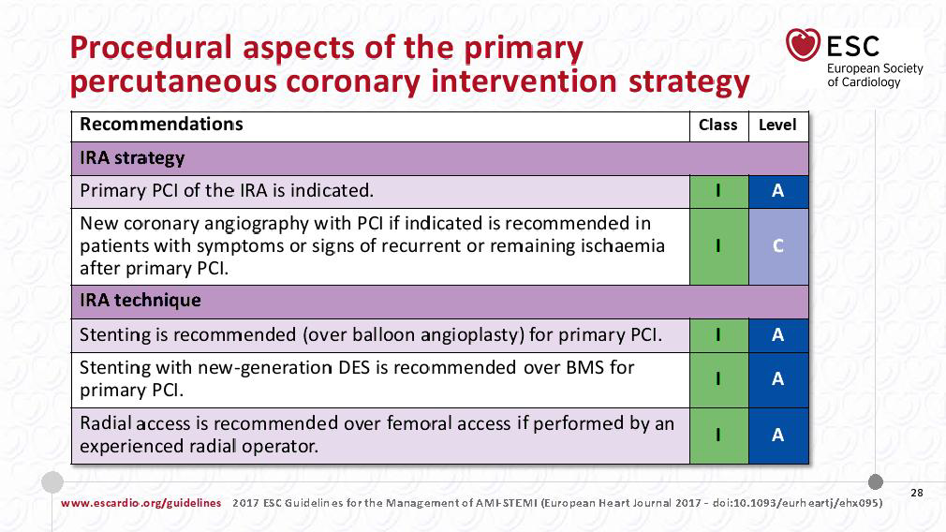

Slide 50
Antiplatelet Therapy to Support Primary PCI for STEMI
I
IIa
IIb
III
Aspirin 162 to 325 mg should be given before primary PCI.
B
I
IIa
IIb
III
After PCI, aspirin should be continued indefinitely.
A

Slide 51
Antiplatelet Therapy to Support Primary PCI for STEMI
I
IIa
IIb
III
A loading dose of a P2Y₁₂ receptor inhibitor should be given as early as possible or at time of primary PCI to patients with STEMI. Options include:
B
Clopidogrel 600 mg; or
Prasugrel 60 mg; or
Ticagrelor 180 mg

Slide 52
Antiplatelet Therapy to Support Primary PCI for STEMI
I
IIa
IIb
III
P2Y₁₂ inhibitor therapy should be given for 1 year to patients with STEMI who receive a stent (BMS or DES) during primary PCI using the following maintenance doses:
B
Clopidogrel 75 mg daily; or
Prasugrel 10 mg daily; or
Ticagrelor 90 mg twice a day*
*The recommended maintenance dose of aspirin to be used with ticagrelor is 81 mg daily.

Slide 53
Antiplatelet Therapy to Support Primary PCI for STEMI
I
IIa
IIb
III
It is reasonable to use 81 mg of aspirin per day in preference to higher maintenance doses after primary PCI.
B

Slide 54
Antiplatelet Therapy to Support Primary PCI for STEMI
It is reasonable to start treatment with an intravenous GP IIb/IIIa receptor antagonist at the time of primary PCI (with or without stenting or clopidogrel pretreatment) in selected patients if E/O no reflow or thrombotic complication.
I
IIa
IIb
III
A
Abciximab: 0.25 mg/kg IV bolus, then 0.125 mcg/kg/min (maximum 10 mcg/min); or
I
IIa
IIb
III
High-bolus-dose tirofiban: 25 mcg/kg IV bolus, then 0.15 mcg/kg/min; or
B
I
IIa
IIb
III
Double-bolus eptifibatide: 180 mcg/kg IV bolus, then 2 mcg/kg/min; a 2nd 180-mcg/kg bolus is administered 10 min after the 1st bolus.
B

Slide 55
Antiplatelet Therapy to Support Primary PCI for STEMI
I
IIa
IIb
III
It may be reasonable to administer intravenous GP IIb/IIIa receptor antagonist in the precatheterization laboratory setting (e.g., ambulance, ED) to patients with STEMI for whom primary PCI is intended.
B
I
IIa
IIb
III
It may be reasonable to administer intracoronary abciximab to patients with STEMI undergoing primary PCI.
B
I
IIa
IIb
III
Continuation of a P2Y₁₂ inhibitor beyond 1 year may be considered in patients undergoing DES placement.

Slide 56
Antiplatelet Therapy to Support Primary PCI for STEMI
I
IIa
IIb
III
Prasugrel should not be administered to patients with a history of prior stroke or transient ischemic attack.
B
Harm

Slide 57
Reperfusion at a PCI-Capable Hospital
Anticoagulant Therapy to Support Primary PCI

Slide 58
Anticoagulant Therapy to Support Primary PCI
For patients with STEMI undergoing primary PCI, the following supportive anticoagulant regimens are recommended:
I
IIa
IIb
III
UFH, with additional boluses administered as needed to maintain therapeutic activated clotting time levels, taking into account whether a GP IIb/IIIa receptor antagonist has been administered; or
I
IIa
IIb
III
Bivalirudin with or without prior treatment with UFH.
B

Slide 59
Anticoagulant Therapy to Support Primary PCI
I
IIa
IIb
III
In patients with STEMI undergoing PCI who are at high risk of bleeding, it is reasonable to use bivalirudin monotherapy in preference to the combination of UFH and a GP IIb/IIIa receptor antagonist.
B
I
IIa
IIb
III
Fondaparinux should not be used as the sole anticoagulant to support primary PCI because of the risk of catheter thrombosis.
B
Harm

Slide 60
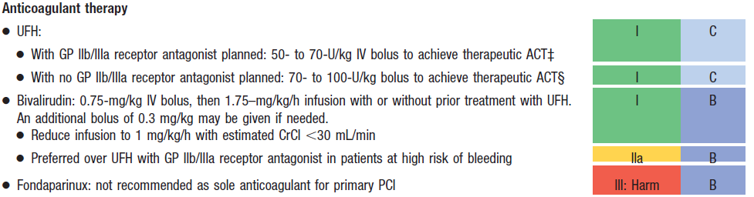
Adjunctive Antithrombotic Therapy to Support Reperfusion With Primary PCI (cont.)
‡The recommended ACT with planned GP IIb/IIIa receptor antagonist treatment is 200 to 250 s.
§The recommended ACT with no planned GP IIb/IIIa receptor antagonist treatment is 250 to 300 s (HemoTec device) or 300 to 350 s (Hemochron device).

Slide 61
Duration of DAPT in Patients With ACS Treated With PCI 2016
COR | LOE | Recommendations
I | B-R | In patients with ACS treated with DAPT after BMS or DES implantation, P2Y₁₂ inhibitor therapy (clopidogrel, prasugrel, or ticagrelor) should be given for at least 12 months.
I | B-NR | In patients treated with DAPT, a daily aspirin dose of 81 mg (range, 75 mg to 100 mg) is recommended.
IIa | B-R | In patients with ACS treated with DAPT after coronary stent implantation, it is reasonable to use ticagrelor in preference to clopidogrel for maintenance P2Y₁₂ inhibitor therapy.
IIa | B-R | In patients with ACS treated with DAPT after coronary stent implantation, who are not at high risk for bleeding complications and who do not have a history of stroke or TIA, it is reasonable to choose prasugrel over clopidogrel for maintenance P2Y₁₂ inhibitor therapy.

Slide 62
COR | LOE | Recommendations
IIb | A ^{SR} | In patients with ACS treated with coronary stent implantation who have tolerated DAPT without bleeding complication and who are not at high bleeding risk (e.g., prior bleeding on DAPT, coagulopathy, oral anticoagulant use) continuation of DAPT for longer than 12 months may be reasonable.
IIb | C-LD | In patients with ACS treated with DAPT after DES implantation who develop a high risk of bleeding (e.g., treatment with oral anticoagulant therapy), are at high risk of severe bleeding complication (e.g., major intracranial surgery), or develop significant overt bleeding, discontinuation of P2Y₁₂ therapy after 6 months may be reasonable.
III: Harm | B-R | Prasugrel should not be administered to patients with a prior history of stroke or TIA.

Slide 63


Algorithm for the use of antithrombotic drugs in patients undergoing percutaneous coronary intervention
Extended DAPT

Slide 64
Extended Duration DAPT

Slide 65
Factors Associated with Increased Bleeding Risk
1. | Need for OAC in addition to DAPT
2. | Advanced age (> 75 years)
3. | Frailty
4. | Anemia with hemoglobin < 110 g/dL
5. | Chronic renal failure (creatinine clearance < 40 mL/min)
6. | Low Body Weight (< 60 kg)
7. | Hospitalization for bleeding within last year
8. | Prior stroke/intracranical bleed
9. | Regular need for NSAIDS or prednisone
J Am Coll Cardiol. 2014;63(9):891–900

Slide 66
Reperfusion at a Non–PCI-Capable Hospital
Fibrinolytic Therapy When There Is an Anticipated Delay to Performing Primary PCI Within 120 Minutes of FMC

Slide 67
Fibrinolytic Therapy When There Is an Anticipated Delay to Performing Primary PCI Within 120 Minutes of FMC
I
IIa
IIb
III
In the absence of contraindications, fibrinolytic therapy should be given to patients with STEMI and onset of ischemic symptoms within the previous 12 hours when it is anticipated that primary PCI cannot be performed within 120 minutes of FMC.
A
I
IIa
IIb
III
In the absence of contraindications and when PCI is not available, fibrinolytic therapy is reasonable for patients with STEMI if there is clinical and/or ECG evidence of ongoing ischemia within 12 to 24 hours of symptom onset and a large area of myocardium at risk or hemodynamic instability.
I
IIa
IIb
III
Fibrinolytic therapy should not be administered to patients with ST depression except when a true posterior (inferobasal) MI is suspected or when associated with ST elevation in lead aVR.
B
Harm

Slide 68
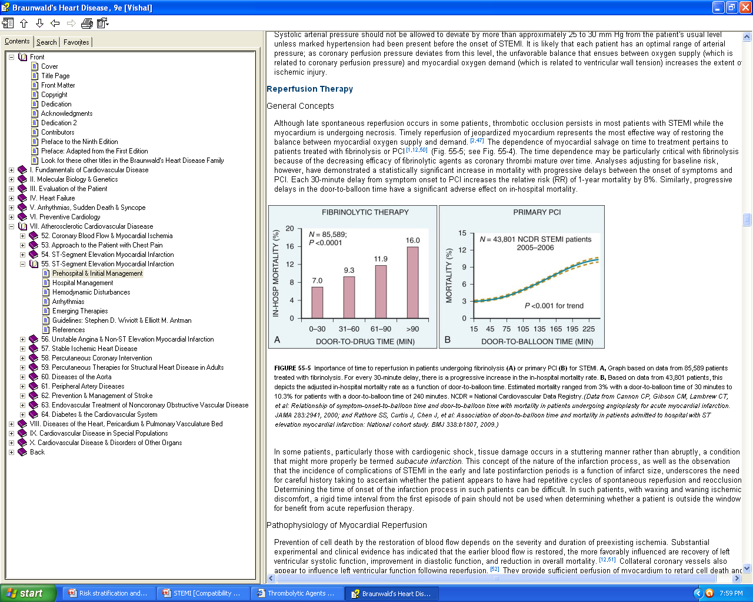
Importance of time to reperfusion in patients undergoing fibrinolysis
(National Cardiovascular Data Registry )

Slide 69
Contraindications and Cautions for Fibrinolysis in STEMI
Absolute Contraindications:
    Any prior intracranial hemorrhage
    Known structural cerebral vascular lesion
    Known malignant intracranial neoplasm
    Ischemic stroke within 3 months EXCEPT acute ischemic stroke within 4.5 hours
    Suspected aortic dissection
    Active bleeding or bleeding diathesis (excluding menses)
    Significant closed-head or facial trauma within 3 months
    For streptokinase- previous treatment within the previous b6 month
A report of the American College of Cardiology Foundation/American Heart Association Task Force on Practice Guidelines. J Am Coll Cardiol 61:e78, 2013.
Note: Age restriction for fibrinolysis has been removed compared with prior guidelines.

Slide 70
Relative Contraindications:
    Severe uncontrolled hypertension on presentation (SBP > 180 or DBP > 110)
    Prior ischemic stroke >3 months
    Traumatic or prolonged (> 10 mt.) CPR or major surgery (< 3 weeks)
    Recent (< 2 to 4 weeks) internal bleeding
    Noncompressible vascular punctures
    Pregnancy, Active peptic ulcer
    Current use of anticoagulants

Slide 71
PARAMETER | STREPTOKINASE | ALTEPLASE | RETEPLASE | TNK t-PA
Dose | 1.5 MU in 30-60 min | Up to 100 mg in 90 min (based on weight) | 10 U +10 U iv boluses (30 min apart) each over 2 min | 30-50 mg based on weight
Bolus administration | No | No | Yes | Yes
Antigenic | Yes | No | No | No
Allergic reactions hypotension most common | Yes | No | No | No
Systemic fibrinogen depletion | Marked | Mild | Moderate | Minimal
90-min patency rates (%) | ≈60- 68 | ≈75-84 | ≈84 | ≈85
TIMI grade 3 flow (%) | 32 | 54 | 60 | 63
Cost per dose (Rs) | 2500 | 39375 (50mg)

Slide 72
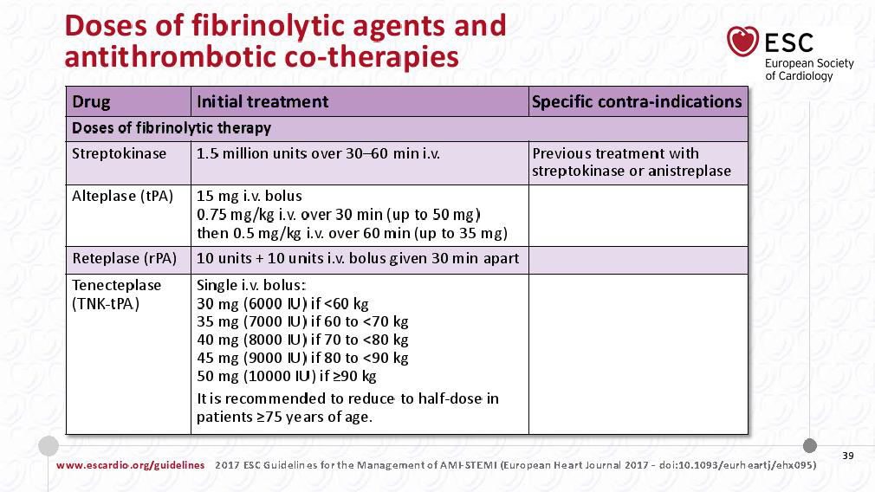

Slide 73
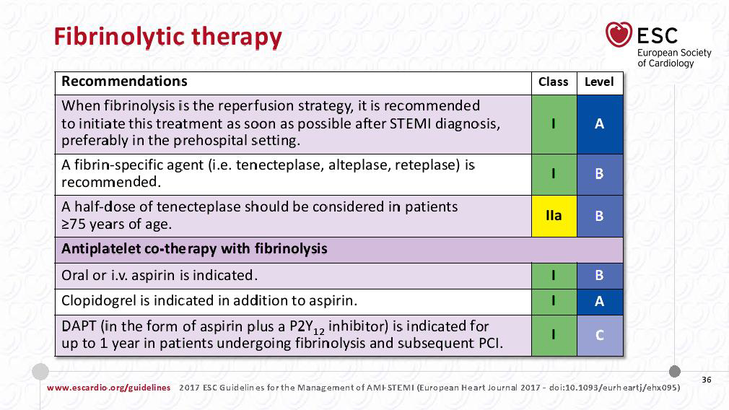

Slide 74
Reperfusion at a Non–PCI-Capable Hospital
Adjunctive Anticoagulant Therapy With Fibrinolysis

Slide 75
Adjunctive Anticoagulant Therapy With Fibrinolysis
I
IIa
IIb
III
Patients with STEMI undergoing reperfusion with fibrinolytic therapy should receive anticoagulant therapy for a minimum of 48 hours, and preferably for the duration of the index hospitalization, up to 8 days or until revascularization if performed. Recommended regimens include:
A
I
IIa
IIb
III
UFH administered as a weight-adjusted intravenous bolus and infusion to obtain an activated partial thromboplastin time of 1.5 to 2.0 times control, for 48 hours or until revascularization;
Enoxaparin administered according to age, weight, and creatinine clearance, given as an intravenous bolus, followed in 15 minutes by subcutaneous injection for the duration of the index hospitalization, up to 8 days or until revascularization; or
Fondaparinux administered with initial intravenous dose, followed in 24 hours by daily subcutaneous injections if the estimated creatinine clearance is greater than 30 mL/min, for the duration of the index hospitalization, up to 8 days or until revascularization.
I
IIa
IIb
III
A
I
IIa
IIb
III
B

Slide 76
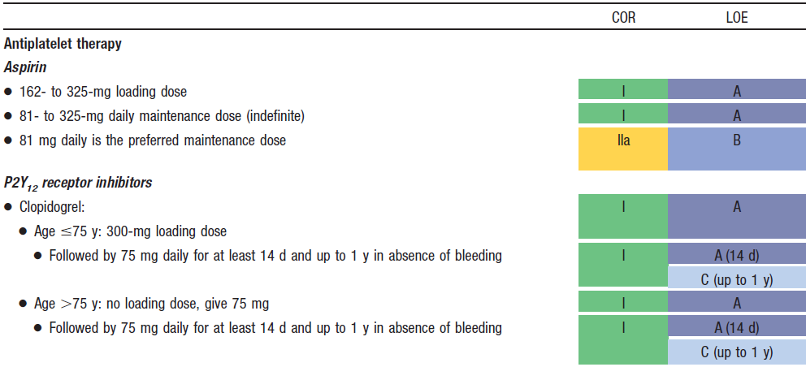
Adjunctive Antithrombotic Therapy to Support Reperfusion With Fibrinolytic Therapy

Slide 77
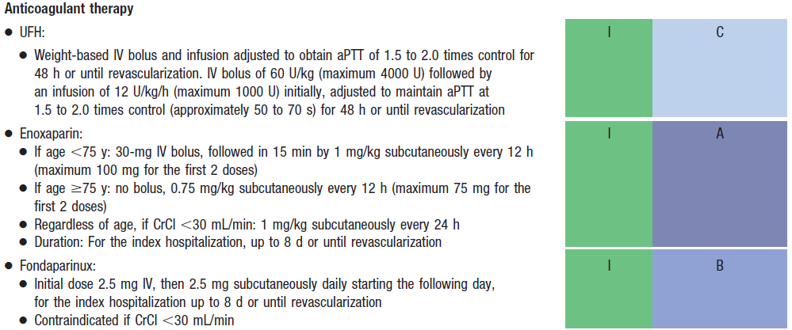
Adjunctive Antithrombotic Therapy to Support Reperfusion With Fibrinolytic Therapy (cont.)

Slide 78
Duration of DAPT in Patients With STEMI Treated With Fibrinolytic Therapy (2016)
COR | LOE | Recommendations
I | A | In patients with STEMI treated with DAPT in conjunction with fibrinolytic therapy, P2Y₁₂ inhibitor therapy (clopidogrel) should be continued for a minimum of 14 days (Level of Evidence: A) and ideally at least 12 months (Level of Evidence: C-EO).
 | C-EO
I | B-NR | In patients treated with DAPT, a daily aspirin dose of 81 mg (range, 75 mg to 100 mg) is recommended.
IIb | A ^{SR} | In patients with STEMI treated with fibrinolytic therapy who have tolerated DAPT without bleeding complication and who are not at high bleeding risk (e.g., prior bleeding on DAPT, coagulopathy, oral anticoagulant use), continuation of DAPT for longer than 12 months may be reasonable.

Slide 79
Reperfusion at a Non–PCI-Capable Hospital
Transfer of Patients With STEMI to a PCI-Capable Hospital for Coronary Angiography After Fibrinolytic Therapy

Slide 80
Transfer of Patients With STEMI to a PCI-Capable Hospital for Coronary Angiography After Fibrinolytic Therapy
I
IIa
IIb
III
Immediate transfer to a PCI-capable hospital for coronary angiography is recommended for suitable patients with STEMI who develop cardiogenic shock or acute severe HF, irrespective of the time delay from MI onset.
B
I
IIa
IIb
III
Urgent transfer to a PCI-capable hospital for coronary angiography is reasonable for patients with STEMI who demonstrate evidence of failed reperfusion or reocclusion after fibrinolytic therapy.
B

Slide 81
Transfer of Patients With STEMI to a PCI-Capable Hospital for Coronary Angiography After Fibrinolytic Therapy
I
IIa
IIb
III
Transfer to a PCI-capable hospital for coronary angiography is reasonable for patients with STEMI who have received fibrinolytic therapy even when hemodynamically stable* and with clinical evidence of successful reperfusion. Angiography can be performed as soon as logistically feasible at the receiving hospital, and ideally within 24 hours, but should not be performed within the first 2 to 3 hours after administration of fibrinolytic therapy.
B
*Although individual circumstances will vary, clinical stability is defined by the absence of low output, hypotension, persistent tachycardia, apparent shock, high-grade ventricular or symptomatic supraventricular tachyarrhythmias, and spontaneous recurrent ischemia.

Slide 82
Delayed Invasive Management
Coronary Angiography in Patients Who Initially Were Managed With Fibrinolytic Therapy or Who Did Not Receive Reperfusion

Slide 83
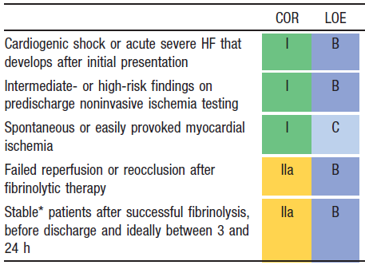
Indications for Coronary Angiography in Patients
Who Were Managed With Fibrinolytic Therapy or Who Did Not Receive Reperfusion Therapy
*Although individual circumstances will vary, clinical stability is defined by the absence of low output, hypotension, persistent tachycardia, apparent shock, high-grade ventricular or symptomatic supraventricular tachyarrhythmias, and spontaneous recurrent ischemia.

Slide 84
Delayed Invasive Management
PCI of an Infarct Artery in Patients Who Initially Were Managed With Fibrinolysis or Who Did Not Receive Reperfusion Therapy

Slide 85
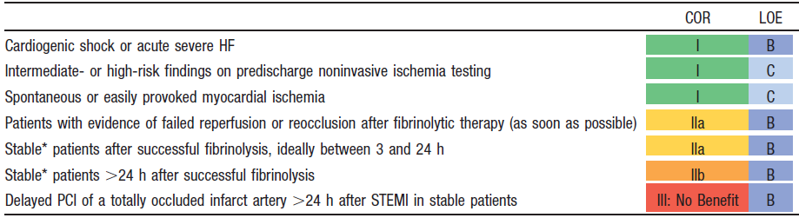
Indications for PCI of an Infarct Artery in Patients Who Were Managed With Fibrinolytic Therapy or Who Did Not Receive Reperfusion Therapy
*Although individual circumstances will vary, clinical stability is defined by the absence of low output, hypotension, persistent tachycardia, apparent shock, high-grade ventricular or symptomatic supraventricular tachyarrhythmias, and spontaneous recurrent ischemia.
Notes:
LATE and EMERAS trials----Fibrinolysis between 12 and 24 hours----No mortality benefit-----Increases risk of cardiac rupture

Slide 86
Delayed Invasive Management
Adjunctive Antithrombotic Therapy to Support Delayed PCI After Fibrinolytic Therapy

Slide 87
Delayed Invasive Management
Antiplatelet Therapy to Support PCI After Fibrinolytic Therapy

Slide 88
Antiplatelet Therapy to Support PCI After Fibrinolytic Therapy
I
IIa
IIb
III
After PCI, aspirin should be continued indefinitely.
A
I
IIa
IIb
III
Clopidogrel should be provided as follows:
A 300-mg loading dose should be given before or at the time of PCI to patients who did not receive a previous loading dose and who are undergoing PCI within 24 hours of receiving fibrinolytic therapy;
A 600-mg loading dose should be given before or at the time of PCI to patients who did not receive a previous loading dose and who are undergoing PCI more than 24 hours after receiving fibrinolytic therapy; and
A dose of 75 mg daily should be given after PCI.

Slide 89
Antiplatelet Therapy to Support PCI After Fibrinolytic Therapy
I
IIa
IIb
III
After PCI, it is reasonable to use 81 mg of aspirin per day in preference to higher maintenance doses.
B
I
IIa
IIb
III
Prasugrel, in a 60-mg loading dose, is reasonable once the coronary anatomy is known in patients who did not receive a previous loading dose of clopidogrel at the time of administration of a fibrinolytic agent, but prasugrel should not be given sooner than 24 hours after administration of a fibrin-specific agent or 48 hours after administration of a non–fibrin-specific agent.
B
I
IIa
IIb
III
Prasugrel, in a 10-mg daily maintenance dose, is reasonable after PCI.
B

Slide 90
Antiplatelet Therapy to Support PCI After Fibrinolytic Therapy
I
IIa
IIb
III
Prasugrel should not be administered to patients with a history of prior stroke or transient ischemic attack.
B
Harm

Slide 91
Delayed Invasive Management
Anticoagulant Therapy to Support PCI After Fibrinolytic Therapy

Slide 92
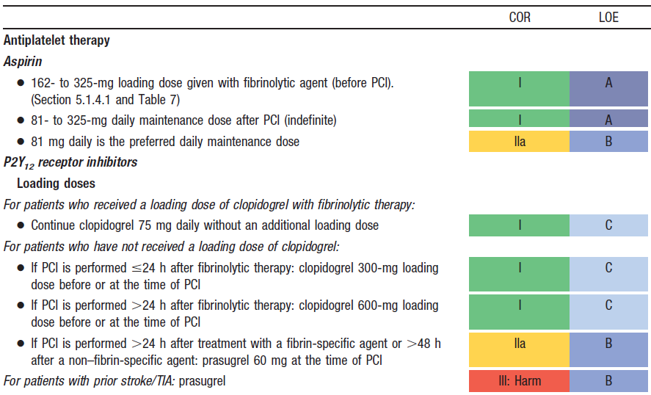
Adjunctive Antithrombotic Therapy to Support PCI After Fibrinolytic Therapy

Slide 93

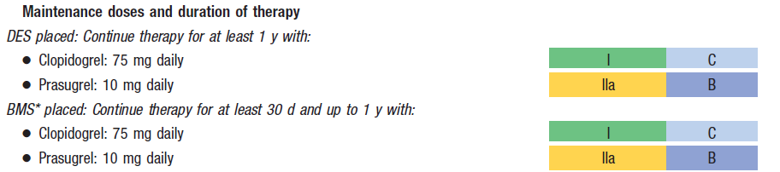
Adjunctive Antithrombotic Therapy to Support PCI After Fibrinolytic Therapy (cont.)
*Balloon angioplasty without stent placement may be used in selected patients. It might be reasonable to provide P2Y₁₂ inhibitor therapy to patients with STEMI undergoing balloon angioplasty after fibrinolysis alone according to the recommendations listed for BMS. (Level of Evidence: C)

Slide 94
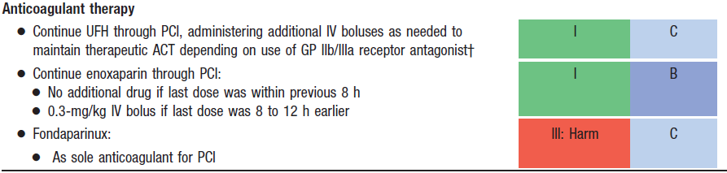
Adjunctive Antithrombotic Therapy to Support PCI After Fibrinolytic Therapy (cont.)
†The recommended ACT with no planned GP IIb/IIIa receptor antagonist treatment is 250–300 s (HemoTec device) or 300–350 s (Hemochron device).

Slide 95
Coronary Artery Bypass Graft Surgery
CABG in Patients With STEMI

Slide 96
CABG in Patients With STEMI
I
IIa
IIb
III
Urgent CABG is indicated in patients with STEMI and coronary anatomy not amenable to PCI who have ongoing or recurrent ischemia, cardiogenic shock, severe HF, or other high-risk features.
B
I
IIa
IIb
III
CABG is recommended in patients with STEMI at time of operative repair of mechanical defects.
B

Slide 97
CABG in Patients With STEMI
I
IIa
IIb
III
The use of mechanical circulatory support is reasonable in patients with STEMI who are hemodynamically unstable and require urgent CABG.
I
IIa
IIb
III
Emergency CABG within 6 hours of symptom onset may be considered in patients with STEMI who do not have cardiogenic shock and are not candidates for PCI or fibrinolytic therapy.

Slide 98
Coronary Artery Bypass Graft Surgery
Timing of Urgent CABG in Patients With STEMI in Relation to Use of Antiplatelet Agents

Slide 99
Timing of Urgent CABG in Patients With STEMI in Relation to Use of Antiplatelet Agents
I
IIa
IIb
III
Aspirin should not be withheld before urgent CABG.
I
IIa
IIb
III
Clopidogrel or ticagrelor should be discontinued at least 24 hours before urgent on-pump CABG, if possible.
B
I
IIa
IIb
III
Short-acting intravenous GP IIb/IIIa receptor antagonists (eptifibatide, tirofiban) should be discontinued at least 2 to 4 hours before urgent CABG.
B

Slide 100
Timing of Urgent CABG in Patients With STEMI in Relation to Use of Antiplatelet Agents
I
IIa
IIb
III
Abciximab should be discontinued at least 12 hours before urgent CABG.
B
I
IIa
IIb
III
Urgent off-pump CABG within 24 hours of clopidogrel or ticagrelor administration might be considered, especially if the benefits of prompt revascularization outweigh the risks of bleeding.
B
I
IIa
IIb
III
Urgent CABG within 5 days of clopidogrel or ticagrelor administration or within 7 days of prasugrel administration might be considered, especially if the benefits of prompt revascularization outweigh the risks of bleeding.

Slide 101
Guideline for STEMI
Routine Medical Therapies

Slide 102
Routine Medical Therapies
Beta Blockers

Slide 103
Beta Blockers
I
IIa
IIb
III
Oral beta blockers should be initiated in the first 24 hours in patients with STEMI who do not have any of the following: signs of HF, evidence of a low output state, increased risk for cardiogenic shock,* or other contraindications to use of oral beta blockers (PR interval >0.24 seconds, second- or third-degree heart block, active asthma, or reactive airways disease).
B
I
IIa
IIb
III
Beta blockers should be continued during and after hospitalization for all patients with STEMI and with no contraindications to their use.
B
*Risk factors for cardiogenic shock (the greater the number of risk factors present, the higher the risk of developing cardiogenic shock) are age >70 years, systolic BP <120 mm Hg, sinus tachycardia >110 bpm or heart rate <60 bpm, and increased time since onset of symptoms of STEMI.

Slide 104
Beta Blockers
I
IIa
IIb
III
Patients with initial contraindications to the use of beta blockers in the first 24 hours after STEMI should be reevaluated to determine their subsequent eligibility.
I
IIa
IIb
III
It is reasonable to administer intravenous beta blockers at the time of presentation to patients with STEMI and no contraindications to their use who are hypertensive or have ongoing ischemia.
B

Slide 105
Routine Medical Therapies
Renin-Angiotensin-Aldosterone System Inhibitors

Slide 106
Renin-Angiotensin-Aldosterone System Inhibitors
I
IIa
IIb
III
An ACE inhibitor should be administered within the first 24 hours to all patients with STEMI with anterior location, HF, or EF less than or equal to 0.40, unless contraindicated.
A
I
IIa
IIb
III
An ARB should be given to patients with STEMI who have indications for but are intolerant of ACE inhibitors.
B

Slide 107
Renin-Angiotensin-Aldosterone System Inhibitors
I
IIa
IIb
III
An aldosterone antagonist should be given to patients with STEMI and no contraindications who are already receiving an ACE inhibitor and beta blocker and who have an EF less than or equal to 0.40 and either symptomatic HF or diabetes mellitus.
B
I
IIa
IIb
III
ACE inhibitors are reasonable for all patients with STEMI and no contraindications to their use.
A

Slide 108
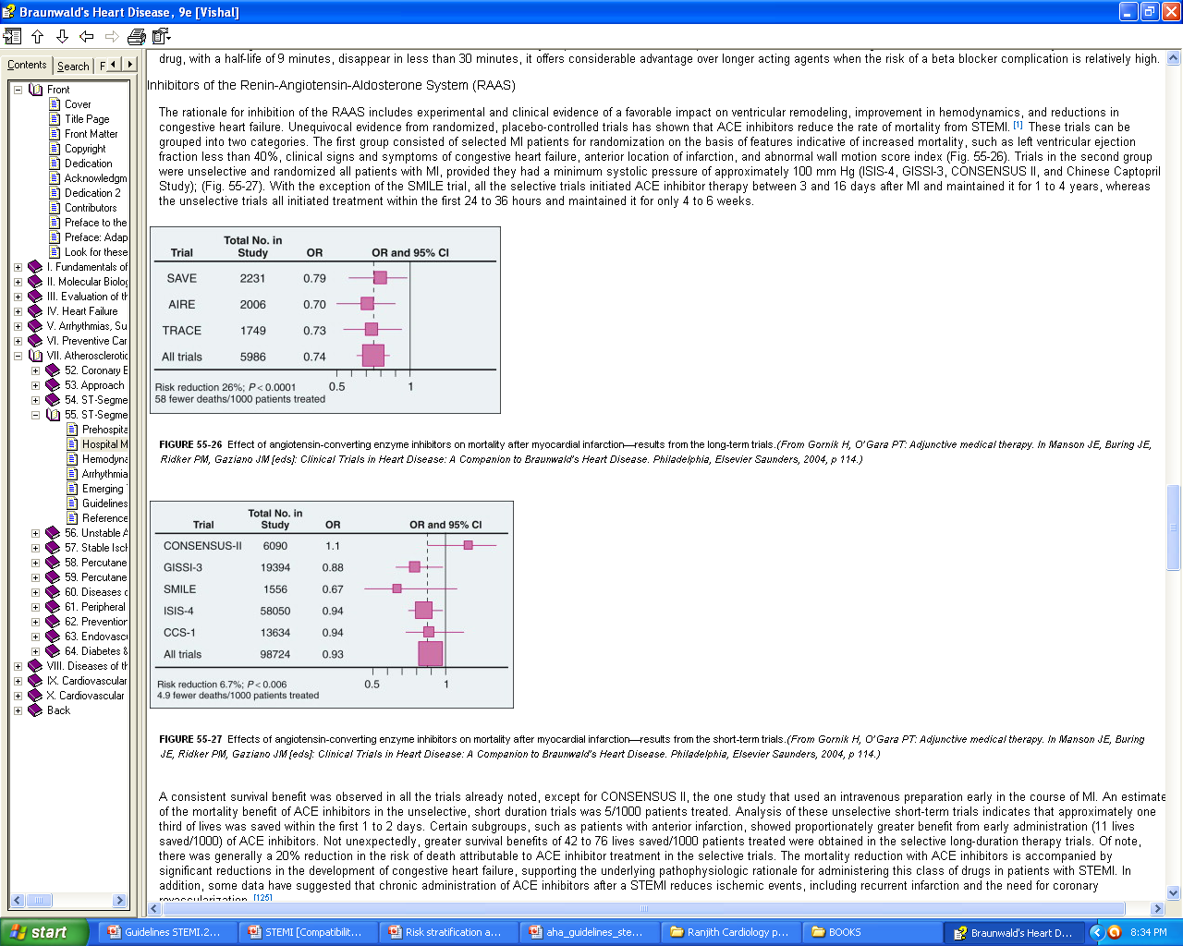
ACE inhibitors on mortality after MI- from short-term trials.

Slide 109
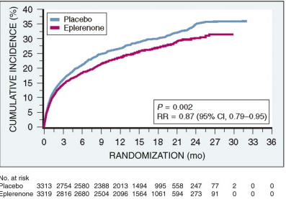
Aldosterone blockade
EPHESUS trial: Eplerenone, 25 mg/day titrated to 50 mg/day for high-risk patients following STEMI (EF ≤40%, clinical HF, DM)
Mean follow-up 16 months, there was a 15% reduction in the RR of mortality

Slide 110
Calcium Channel Antagonists
Immediate-release preparation of nifedipine increased risk of in-hospital mortality
Verapamil & diltiazem can be given for relief of ongoing ischemia or slowing of a rapid ventricular response in AF in patients with contraindication to beta blockers.
INTERCEPT trial compared 300 mg of diltiazem with placebo , Diltiazem did not reduce cardiac death, nonfatal re infarction, during a 6-month follow-up

Slide 111
Glucose Control in STEMI
It is reasonable to use an insulin based regimen to achieve and maintain glucose levels less than 180 mg/dl while avoiding hypoglycemia for patients with STEMI with either a complicated or uncomplicated course
Class IIa(B)

Slide 112
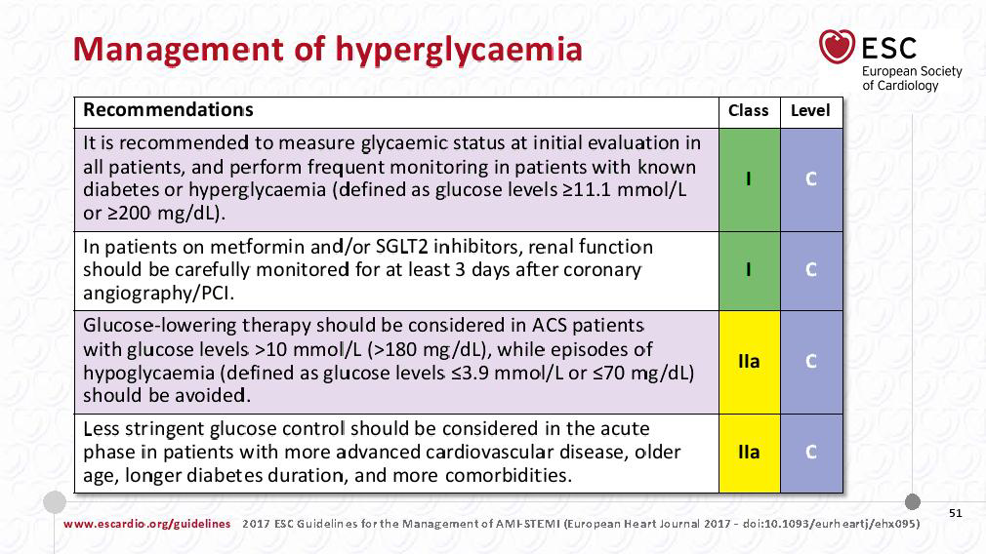

Slide 113
Routine Medical Therapies
Lipid Management

Slide 114
Lipid Management
I
IIa
IIb
III
High-intensity statin therapy should be initiated or continued in all patients with STEMI and no contraindications to its use.
B
I
IIa
IIb
III
It is reasonable to obtain a fasting lipid profile in patients with STEMI, preferably within 24 hours of presentation.

Slide 115
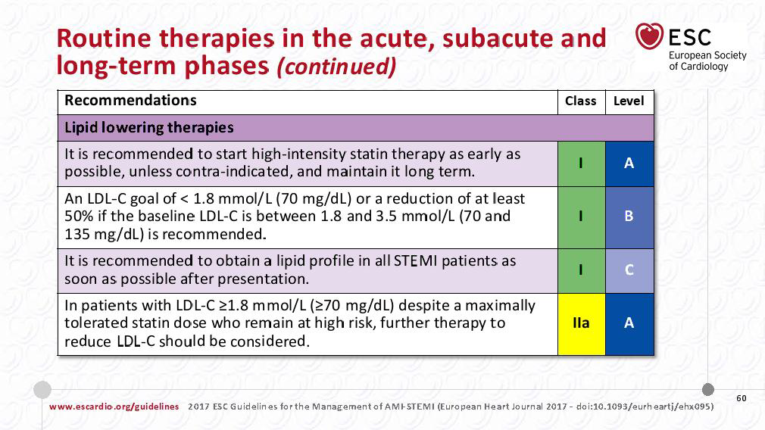

Slide 116
Guideline for STEMI
Complications After STEMI

Slide 117
Complications After STEMI
Cardiogenic Shock

Slide 118
Treatment of Cardiogenic Shock
I
IIa
IIb
III
Emergency revascularization with either PCI or CABG is recommended in suitable patients with cardiogenic shock due to pump failure after STEMI irrespective of the time delay from MI onset.
B
I
IIa
IIb
III
In the absence of contraindications, fibrinolytic therapy should be administered to patients with STEMI and cardiogenic shock who are unsuitable candidates for either PCI or CABG.
B

Slide 119
Treatment of Cardiogenic Shock
I
IIa
IIb
III
The use of intra-aortic balloon pump counterpulsation can be useful for patients with cardiogenic shock after STEMI who do not quickly stabilize with pharmacological.
B
I
IIa
IIb
III
Alternative LV assist devices for circulatory support may be considered in patients with refractory cardiogenic shock.

Slide 120
Treatment of acute LV failure

Slide 121
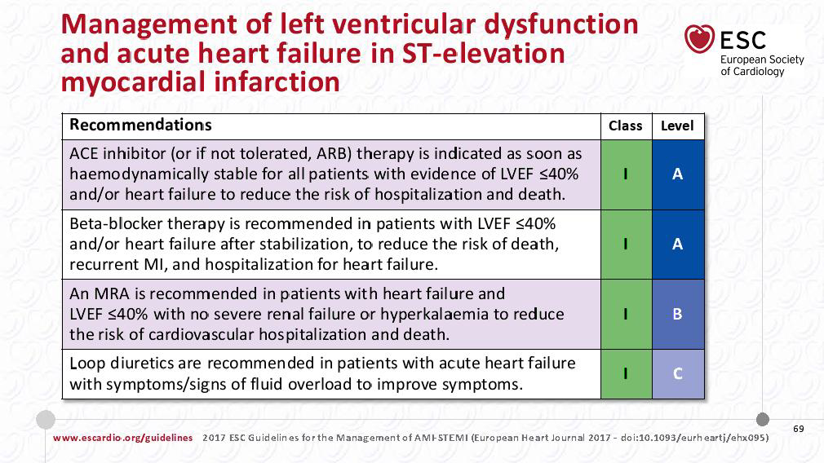

Slide 122
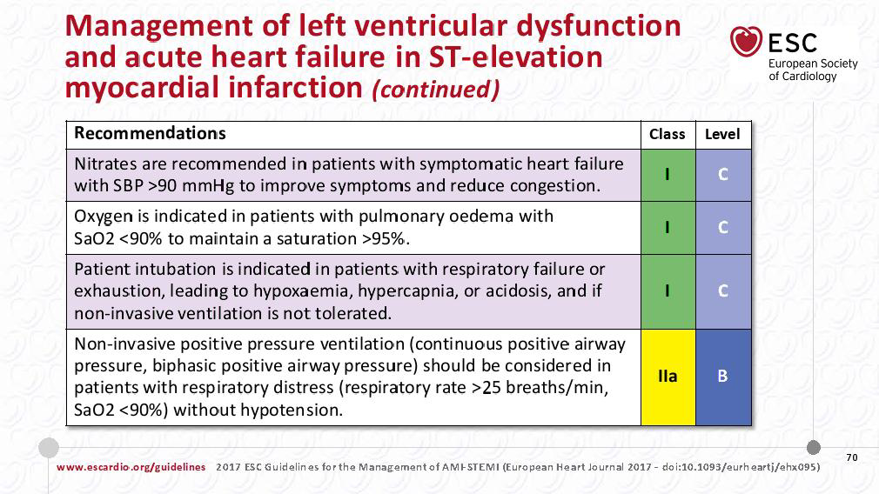

Slide 123
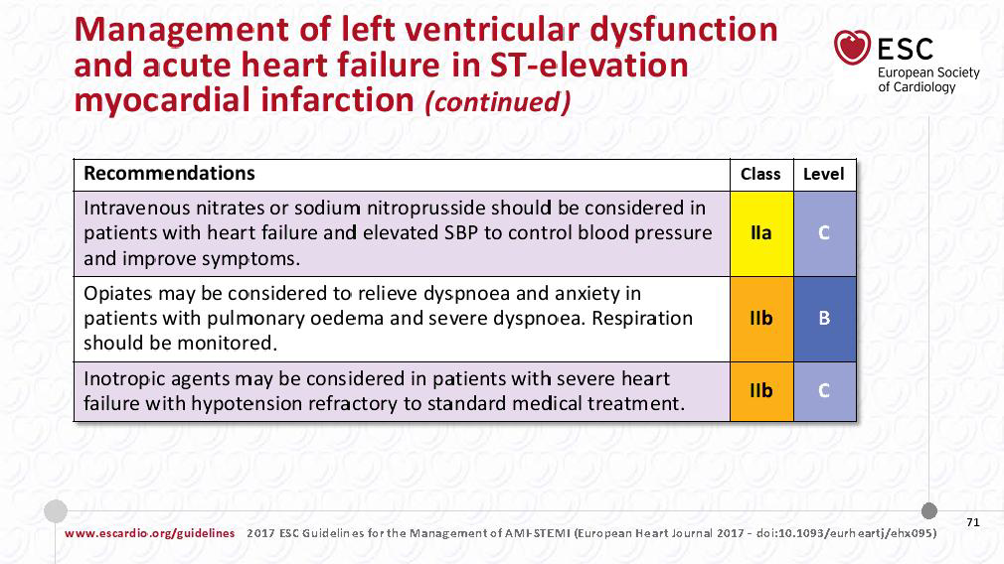

Slide 124
ATRIAL FIBRILLATION

Slide 125
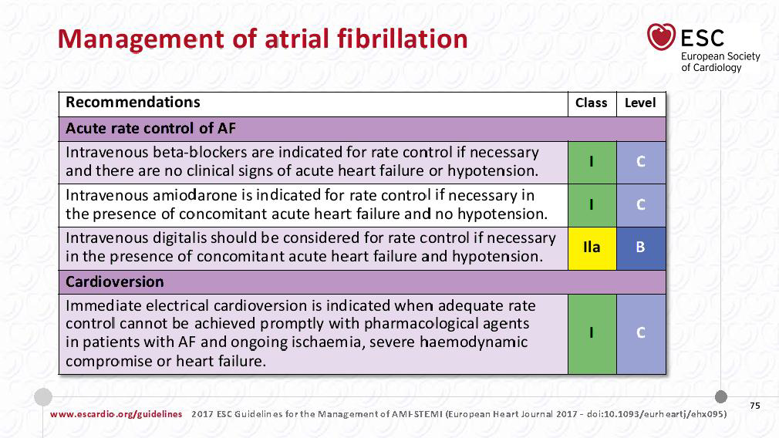

Slide 126
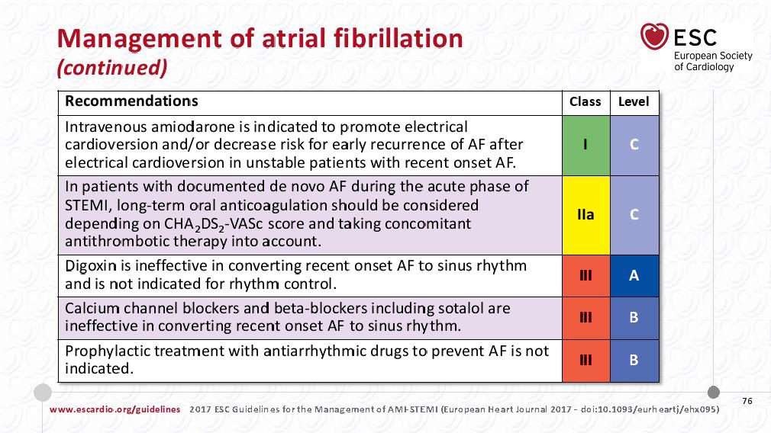

Slide 127
Complications After STEMI
Electrical Complications During the Hospital Phase of STEMI

Slide 128
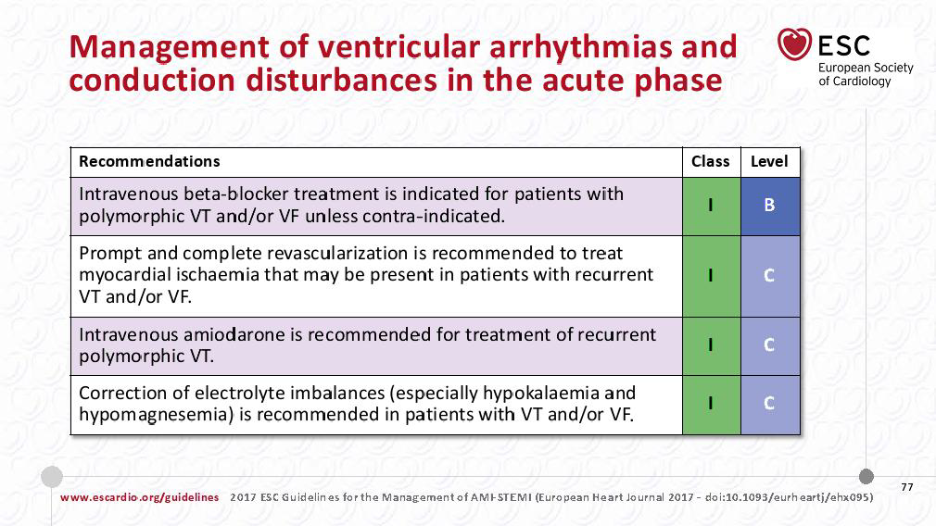

Slide 129
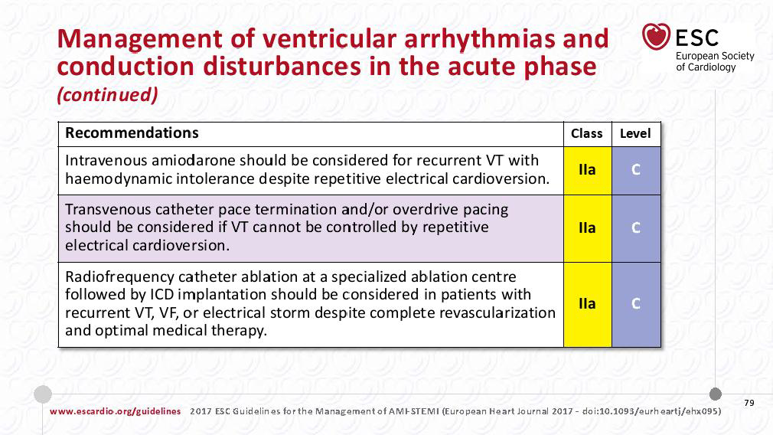

Slide 130
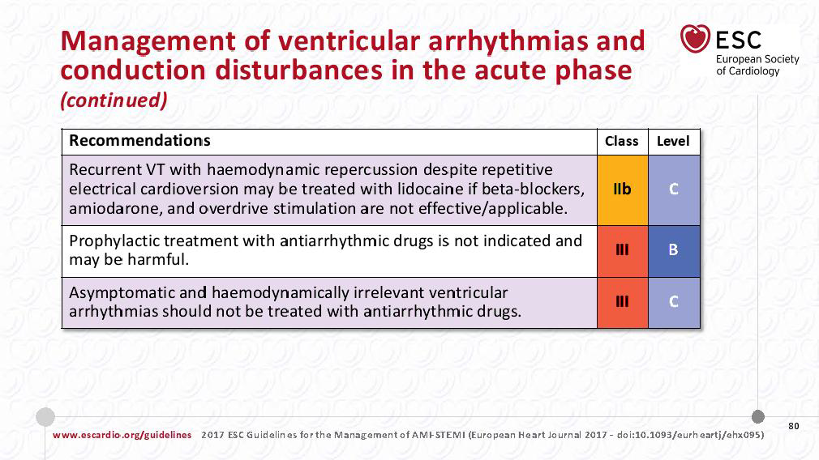

Slide 131
Complications After STEMI
Implantable Cardioverter-Defibrillator Therapy Before Discharge

Slide 132
Implantable Cardioverter-Defibrillator Therapy Before Discharge
I
IIa
IIb
III
ICD therapy is indicated before discharge in patients who develop sustained VT/VF more than 48 hours after STEMI, provided the arrhythmia is not due to transient or reversible ischemia, reinfarction, or metabolic abnormalities.
B

Slide 133
Assessment of Risk for SCD
I
IIa
IIb
III
Patients with an initially reduced LVEF who are possible candidates for ICD therapy should undergo reevaluation of LVEF 40 or more days after discharge.
B

Slide 134
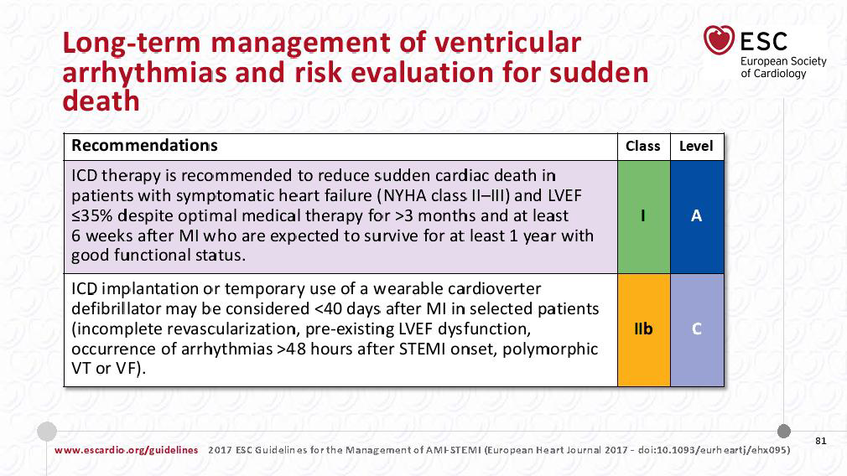

Slide 135
Complications After STEMI
Bradycardia, AV Block, and Intraventricular Conduction Defects

Slide 136
Complications After STEMI
Pacing in STEMI

Slide 137
Pacing in STEMI
I
IIa
IIb
III
Temporary pacing is indicated for symptomatic bradyarrhythmias unresponsive to medical treatment.

Slide 138
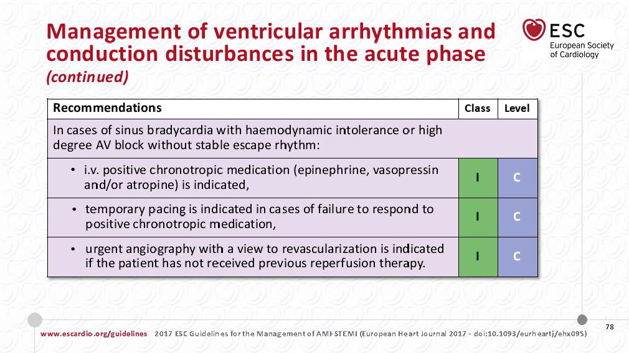

Slide 139
Complications After STEMI
Pericarditis

Slide 140
Complications After STEMI
Management of Pericarditis After STEMI

Slide 141
Management of Pericarditis After STEMI
I
IIa
IIb
III
Aspirin is recommended for treatment of pericarditis after STEMI.
B
I
IIa
IIb
III
Administration of acetaminophen, colchicine, or narcotic analgesics may be reasonable if aspirin, even in higher doses, is not effective.
I
IIa
IIb
III
Glucocorticoids and nonsteroidal antiinflammatory drugs are potentially harmful for treatment of pericarditis after STEMI.
B
Harm

Slide 142
Complications After STEMI
Thromboembolic and Bleeding Complications

Slide 143
Complications After STEMI
Anticoagulation

Slide 144
Anticoagulation

Slide 145
Anticoagulation
I
IIa
IIb
III
Anticoagulant therapy with a vitamin K antagonist should be provided to patients with STEMI and atrial fibrillation with CHADS2* score greater than or equal to 2, mechanical heart valves, venous thromboembolism, or hypercoagulable disorder.
I
IIa
IIb
III
The duration of triple-antithrombotic therapy with a vitamin K antagonist, aspirin, and a P2Y₁₂ receptor inhibitor should be minimized to the extent possible to limit the risk of bleeding.†
*CHADS2 (Congestive heart failure, Hypertension, Age ≥75 years, Diabetes mellitus, previous Stroke/transient ischemic attack (doubled risk weight)) score.
†Individual circumstances will vary and depend on the indications for triple therapy and the type of stent placed during PCI. After this initial treatment period, consider therapy with a vitamin K antagonist plus a single antiplatelet agent. For patients treated with fibrinolysis, consider triple therapy for 14 days, followed by a vitamin K antagonist plus a single antiplatelet agent.

Slide 146
Anticoagulation
I
IIa
IIb
III
Anticoagulant therapy with a vitamin K antagonist is reasonable for patients with STEMI and asymptomatic LV mural thrombi.
I
IIa
IIb
III
Anticoagulant therapy may be considered for patients with STEMI and anterior-apical akinesis or dyskinesis.
I
IIa
IIb
III
Targeting vitamin K antagonist therapy to a lower international normalized ratio (e.g., 2.0 to 2.5) might be considered in patients with STEMI who are receiving DAPT.

Slide 147
Guideline for STEMI
Posthospitalization Plan of Care

Slide 148
Posthospitalization Plan of Care
I
IIa
IIb
III
Posthospital systems of care designed to prevent hospital readmissions should be used to facilitate the transition to effective, coordinated outpatient care for all patients with STEMI.
B
I
IIa
IIb
III
Exercise-based cardiac rehabilitation/secondary prevention programs are recommended for patients with STEMI.
B

Slide 149
Posthospitalization Plan of Care
I
IIa
IIb
III
A clear, detailed, and evidence-based plan of care that promotes medication adherence, timely follow-up with the healthcare team, appropriate dietary and physical activities, and compliance with interventions for secondary prevention should be provided to patients with STEMI.
I
IIa
IIb
III
Encouragement and advice to stop smoking and to avoid secondhand smoke should be provided to patients with STEMI.
A

Slide 150
THANK YOU

